Slide 1

Hash Vault
Understanding Secure Hashing and Storage

Slide 2
What is Hash Vault?
Definition:
A secure storage solution using cryptographic hash functions to protect sensitive data.
Purpose:
Safely store and retrieve passwords, API keys, and other confidential information.
Benefits:
Enhances data security and integrity.
Prevents unauthorized access through effective hashing techniques.

Slide 3
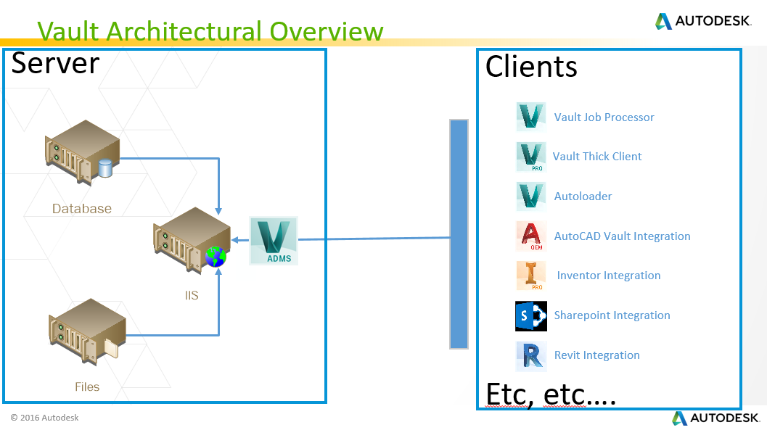

Slide 4
Process
Input Data: Password
Add Salt: Random value added to password.
Hash Function: SHA-256 or similar.
Store: Save hashed password and salt in the database.
Verify: Compare hashed value on retrieval.

Slide 5
Code Demo

Slide 6
Thank You !

